Slide 1
A.I in Smart Cities…
Waste Classifier

Slide 2
Abstract
The accumulation of solid waste in the urban area is becoming a great concern, and it would result in environmental pollution and may be hazardous to human health if it is not properly managed.
It is important to have an advanced/intelligent waste management system to manage a variety of waste materials.
One of the most important steps of waste management is the separation of the waste into the different components and this process is normally done manually by hand-picking.

Slide 3
Introduction
:=> The world bank report showed that there are almost 4 billion tons of waste around the world every year and the urban alone contributes a lot to this number, the waste is predicted to increase by 70 percent in the year 2025 .
:=> According to in the next 25 years, the less developed countries’ waste accumulation will increase drastically. With the increase in the number of industries in the urban area, the disposal of the solid waste is really becoming a big problem, and the solid waste includes paper, wood, plastic, metal, glass etc.

Slide 4
Motivation
:=> The present way of separating waste/garbage is the hand-picking method, whereby someone is employed to separate out the different objects/materials. The person, who separate waste, is prone to diseases due to the harmful substances in the garbage.
:=> With this in mind, it motivated us to develop an automated system which is able to sort the waste. and this system can take short time to sort the waste, and it will be more accurate in sorting than the manual way. With the system in place, the beneficial separated waste can still be recycled and converted to energy and fuel for the growth of the economy.

Slide 5
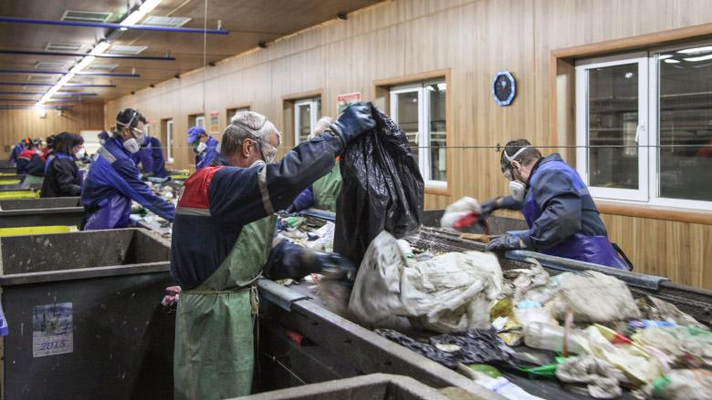
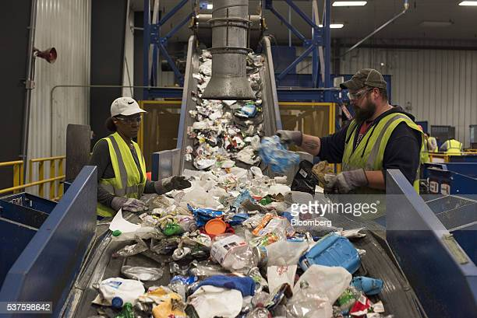
Human Resources wastage during separation:-

Slide 6
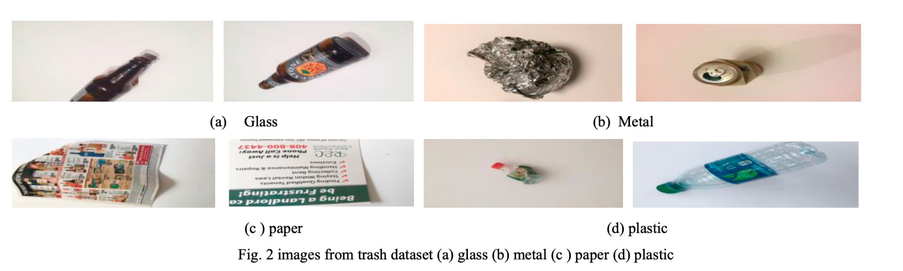

Slide 7
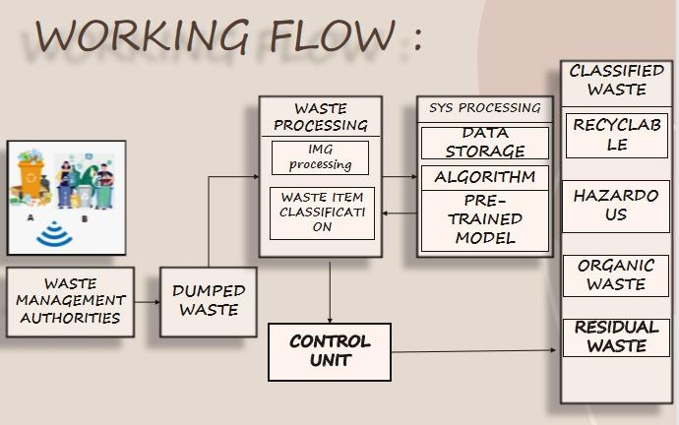

Slide 8

Output Window

Slide 9
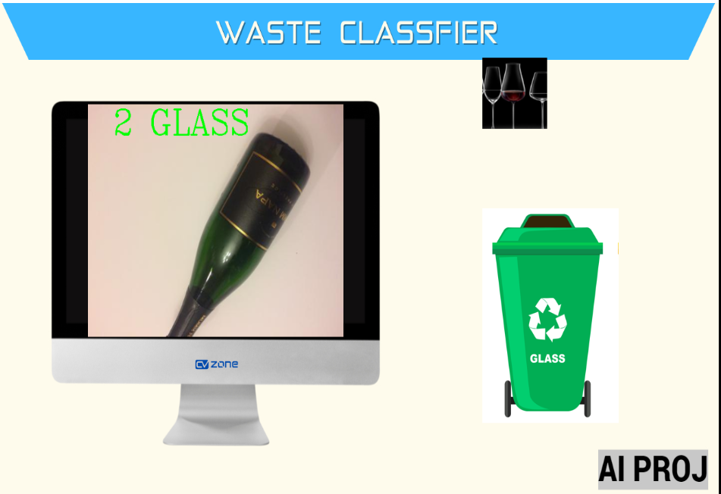
Results

